Slide 1
BytesCode Enhancements
Hibernate Improvements

Slide 2
Summary
Hibernate offers support for instrumenting entity bytecode for three use cases:
lazy initialization (allows entity attributes to be fetched lazily)
dirty tracking (the entity tracks its own property changes)
association management (allows automatic sides synchronization for bidirectional associations)

Slide 3
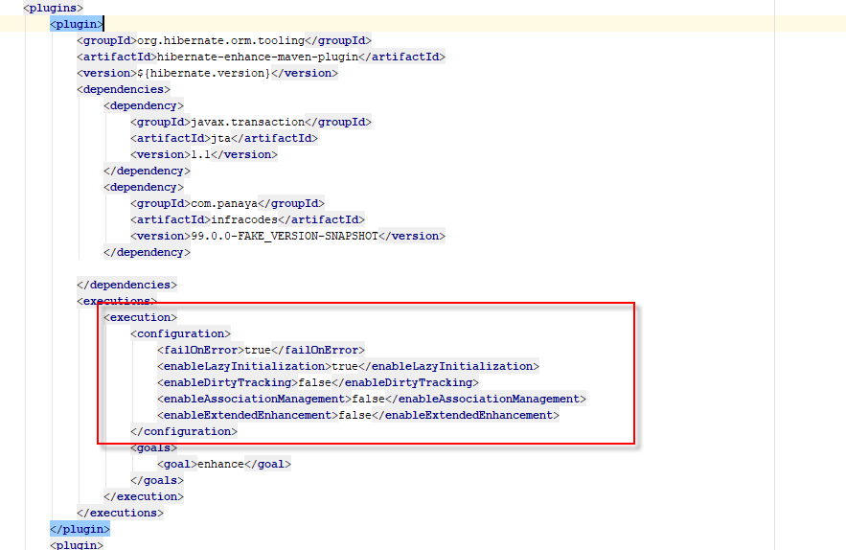
How do we configure the plugin?
In POM.xml , under plugins section – we added this plugin.
This plugin enhances the hibernate entities during compilation time.

Slide 4
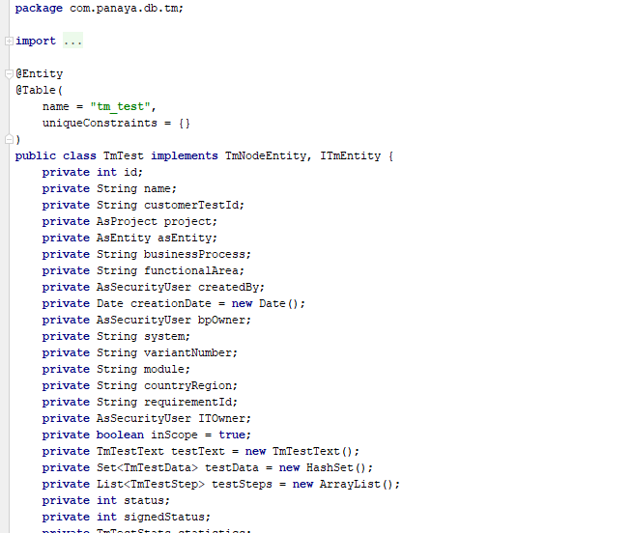
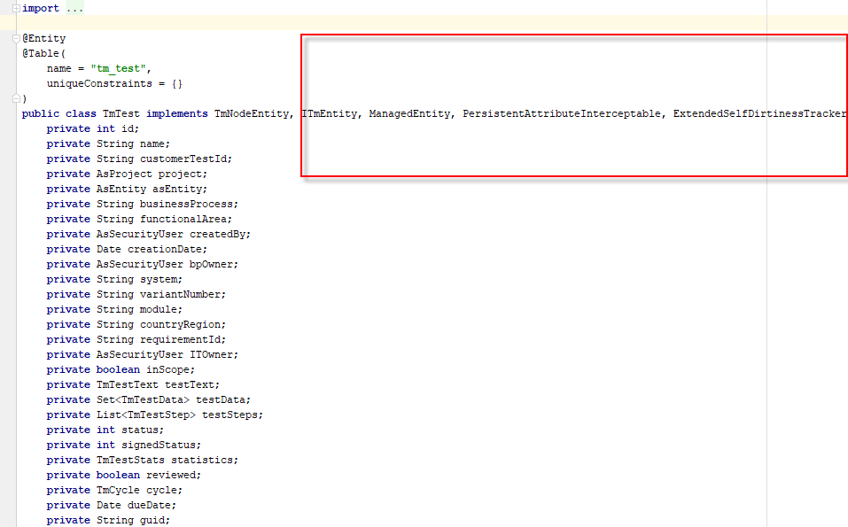
The difference in the compiled class
TmTest.class
before
after

Slide 5
Lazy state initialization

Slide 6
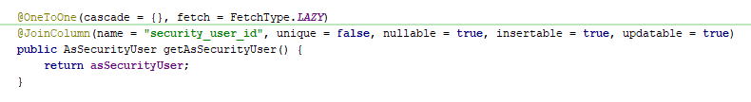
Lazy state initialization
The Issue:
Lazy Loading for this oneToOne- NEVER Worked
Hibernate does not use proxi object for one to one nullable relationship but fetch the data eagerly.

Slide 7
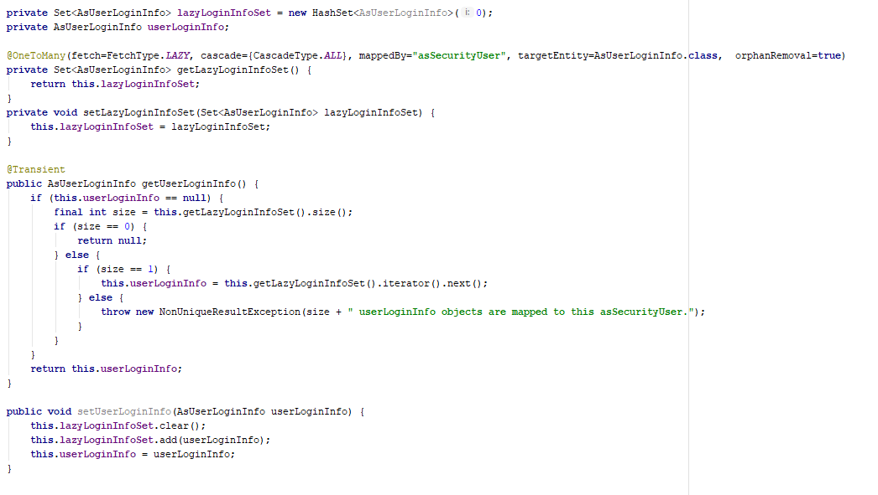
Lazy state initialization
Solution we have today in our code: Fake OneToMany

Slide 8
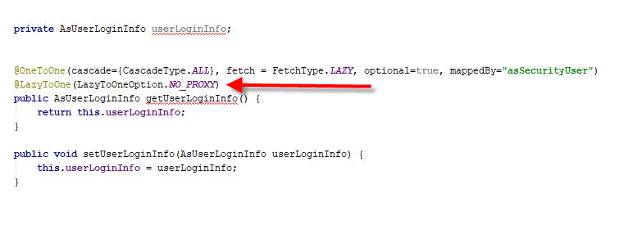
Lazy state initialization
BETTER Solution by bytescode enhancement plugin
The solution includes:
Run bytecode enhancement on the hibernate class
Add annotation of @LazyToOne(NO_PROXI)

Slide 9
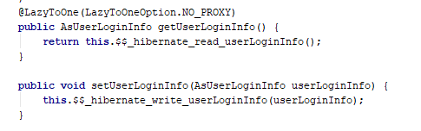
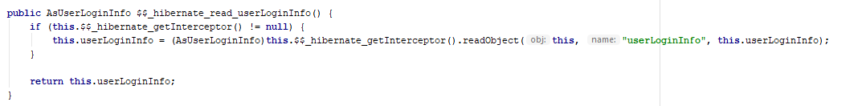
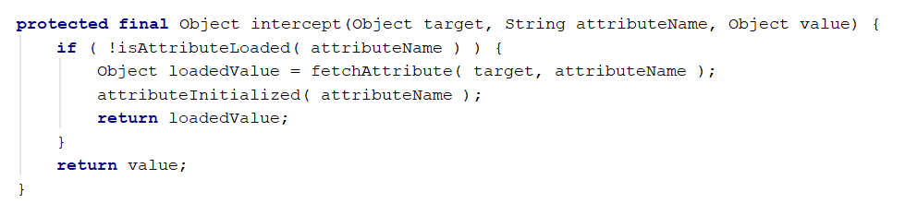
Lazy state initialization
How it is working?
The bytescode enhancement change the getter of the property:

Slide 10
Dirtiness tracking
How the dirty checking behaves in Panaya today ?
Hibernate runs the automatic dirty checking mechanism during flush-time.
and any managed entity state change is translated into an UPDATE SQL statement.
The default dirty checking mechanism uses Java reflection and goes through every property of every managed entity.

Slide 11
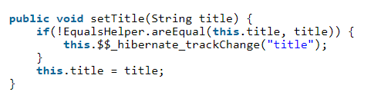

Dirtiness tracking
bytescode enhancement solution:
When enabling the dirty tracking option, Hibernate will track property changes through the following mechanism.
The $$_hibernate_tracker attribute stores every property change, and every setter method will call the $$_hibernate_trackChange method.
During flushing, Hibernate inspects the $$_hibernate_hasDirtyAttributes method to validate if an entity is dirty.

